Slide 1
MODULE 2: 5G Network Architecture
Introduction to 5G Network Architecture
5G Core Network (5GC
Radio Access Network
Network Slicing: Concept and Implementation;
Virtualization in 5G
Software-Defined Networking (SDN) in 5G
Edge Computing
Mobile Edge Computing
Quality of Service requirements.

Slide 2
MODULE 2: 5G Network Architecture
M2 S1
Introduction to 5G Network Architecture

Slide 3
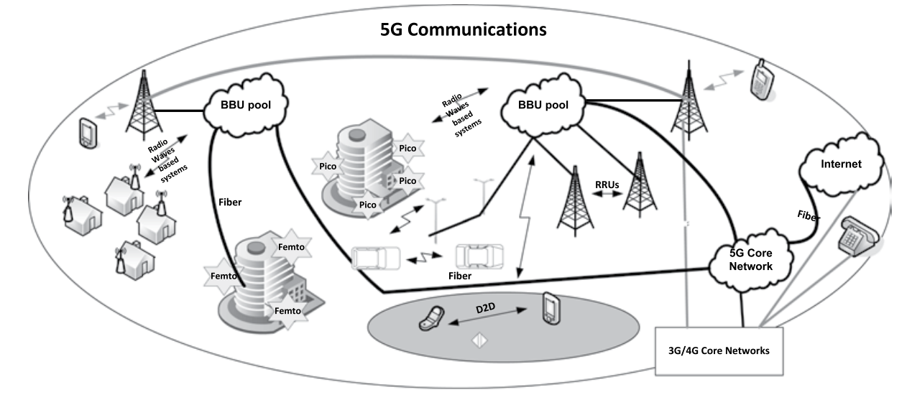
Introduction to 5G Network Architecture
30,000 ft 5G network view

Slide 4
Introduction to 5G Network Architecture
30,000 ft 5G network view
The design of 5G network is still evolving and the sector will take some time to thrash out the details.
Nevertheless, it is expected that the architecture will utilize the cloud functionality and small cells to the deepest extent. A 30,000 ft bird’s eye view, shown in Figure, highlights the key segments of the architecture.
It shows that small cells are connected with either view optical fiber cable or radio waves to the cloud radio access network (BBU pool).
The pools of BBU are connected (which is called the fronthaul) to the RRUs (small cells or macro cells) and are backhauled to the core network.
5G core network in the form of cloud is integrated with existing 3G/4G core networks and provides connectivity to the Internet

Slide 5
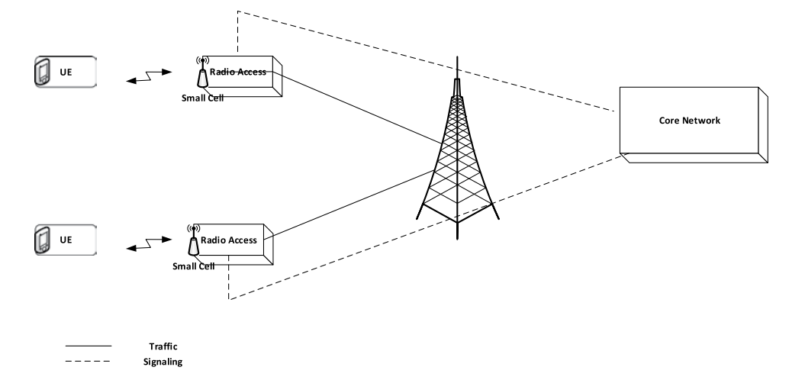
Introduction to 5G Network Architecture
Local routing

Slide 6
Introduction to 5G Network Architecture
5G networks will consist of thousands of small cells making networks ultradense.
This network densification is required to meet the latency and throughput requirements.
Small cells are expected to carry a major portion of traffic with overall data volume expected to grow exponentially as predicted by many studies.
Bringing small cells closer to the user will reduce latency and increase overall network efficiency by creating subnetworks.
These subnetworks can have the functionality to route data traffic locally for the local users’ calls who are communicating with each other while sending the signaling to the main network as shown in Figure.
The net result from local switching is in the savings of network resources and cheaper data plans for the customers

Slide 7
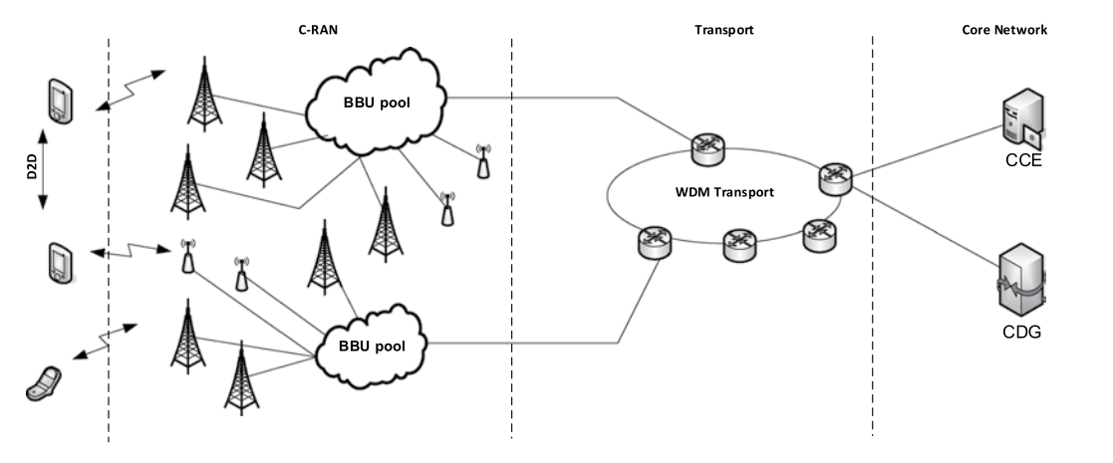
Introduction to 5G Network Architecture
High level 5G network architecture

Slide 8
Introduction to 5G Network Architecture C-RAN
Centralized RAN and Cloud RAN
C-RAN refers to the non-static relationship between BBUs and RRUs.
The name comes from the four “C”s, that is,
Centralized processing,
Clean (Green),
Collaborative radio, and
Cloud Radio Access Network.

Slide 9
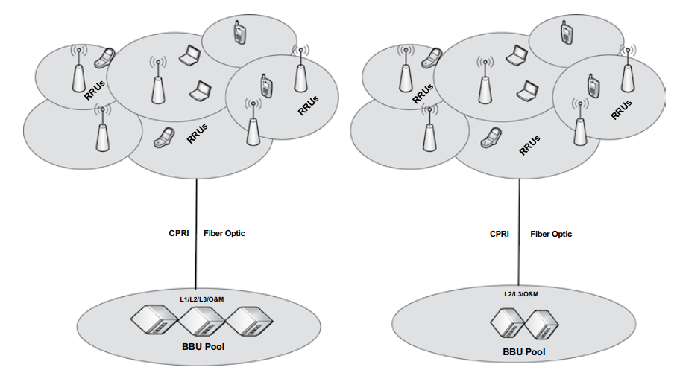
Introduction to 5G Network Architecture C-RAN
Partially Centralized
Fully Centralized

Slide 10
Introduction to 5G Network Architecture C-RAN
Some key elements and functionalities of this architecture are
1. Transport
2. Interface
3. Virtualization
Fully Centralized
Partially Centralized

Slide 11
Introduction to 5G Network Architecture C-RAN Architecture
Transport:
The connectivity between BBUs and RRUs in C-RAN is provided through fronthaul which is for the most part is supported via optical fiber cable, but in some cases, wireless links are also used.
Wireless links are essential since it is very difficult to extend fiber to every RRU site.
It is pertinent to note that as the distances for BBUs and RRUs run to 10s of kilometers, a mix of wired (fiber, Ethernet) and wireless technology may have to be utilized.
Furthermore, in some cases, repeater sites may be placed between RRU sites and pools of BBUs to address terrain, right-of-way, and monetary challenges.

Slide 12
Introduction to 5G Network Architecture C-RAN Architecture
Interface(s):
C-RAN is primarily supported by CPRI (common protocol radio interface).
The CPRI release 7.0 which was published in October 2015, specifies ten-line bit rate options with the lowest at 614.4 Mbps and the highest at 24.3 Gbps.
It is essential for BBUs and RRUs to support at least one such bit rate.
CPRI protocol is sensitive to latency and the synchronization performance of a transmission system, so in a number of cases, it is limited to a distance of about 40 km.

Slide 13
Introduction to 5G Network Architecture C-RAN Architecture
Virtualization:
The placement of a number of BBUs in a centralized pool while distributing RRUs according to targeted RF strategies means that operators employ virtualization technology that maps radio signals from/to one RRU to any BBU processing entity in the pool.
The functions of BBUs may be realized through software instances making those virtual base stations.
However, full virtualization is more of a long-term solution necessitating the use of virtualized BBUs running on commercial servers within an NFV (Network Function Virtualization) platform.

Slide 14
Introduction to 5G Network Architecture key benefits of C-RAN are
Energy Efficient Infrastructure:
C-RAN is an eco-friendly and energy efficient concept.
The BBU pool in C-RAN is a shared resource, thus low power consumption and better load balancing can be achieved by dynamically allocating processing capability during a 24-hour period.
During night time, several BBUs can either be turned off or put on low power to save energy without affecting the 24/7 service commitment.
Cost Savings:
The centralization allows placement of BBU pools in a few locations which will save O&M (operations and maintenance) costs.
With C-RAN, transmission equipment can be shared as well, reducing CAPEX (Capital Expenditure) as well OPEX (Operational Expenditure) to some extent.

Slide 15
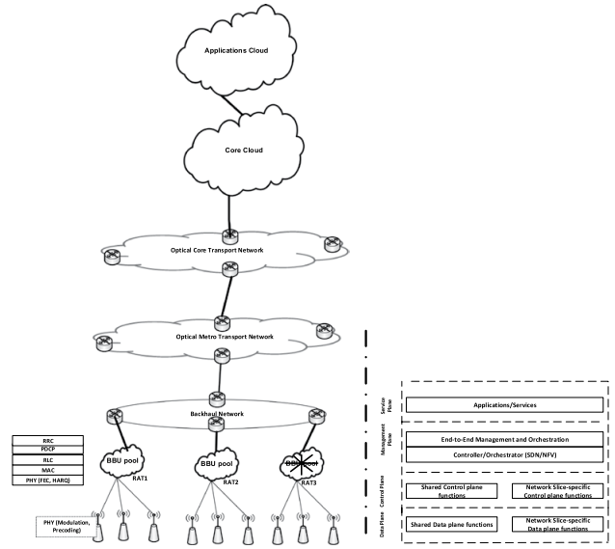
Introduction to 5G Network Architecture

Slide 16
Introduction to 5G Network Architecture key benefits of C-RAN are
Improved Spectrum Utilization::
C-RAN allows implementation of joint processing and scheduling to mitigate intercell interference which improves spectral efficiency.
For example, CoMP (Cooperative Multi-point Processing) technique of LTE-Advanced, which mitigates intercell interference, can be implemented under the C-RAN infrastructure.
New Business Models:
Cloud RAN may bring new as well as enhance existing business models such as base station (BS) pool resource rental system, cellular infrastructure sharing, intellectual property pooling (patent pooling), and so on.

Slide 17
!!THANK YOU!! !! Have a Nice Day!!
Today we learned about
Introduction to 5G Network Architecture

